Slide 1
NAON Education COMMITTEE (NEC)
Member Orientation
Allison Walker, MS, CNP

Slide 2
Agenda
Introductions
ANCC Accreditation
Provider Unit Responsibilities
Committee member responsibilities

Slide 3
Introductions
Name
Background
Current Role
What are you most looking forward about joining the NEC?

Slide 4


Accreditation
The ANCC Accreditation Program formally recognizes organizations
that provide high-quality continuing nursing education (Accredited providers). To achieve this recognition, an eligible organization engages in a comprehensive analysis of its structure, processes, and outcomes. NAON is accredited to provide Nursing Continuing education (Ground Level)
(Broader picture) to support collaboration and interprofessional education, the ANCC Accreditation Program recognizes organizations providing interprofessional continuing education for the health care team. This Joint Accreditation Program is managed in collaboration with the Accreditation Council for Continuing Medical Education (ACCME) and the Accreditation Council for Pharmacy Education (ACPE).

Slide 5
ANCC - Accreditation
Reaccredited in 2024 - next recertification 2027
The ANCC Accreditation Program supports the lifelong learning needs of professional registered nurses by ensuring
that educational activities are designed using criteria that are evidence-based and independent from commercial
influence. By participating in continuing nursing education developed by accredited organizations, professional
registered nurses are able to maintain continued competence in a rapidly changing healthcare environment.

Slide 6

ANCC - Basic Principles

Slide 7
NAON Organizational Chart
NAON Membership
NAON Board Liaisons
NAON Executive Board
NAON Executive Director
Kristen Phillips
NAON Task Forces and Committees
NAON Provider Unit
Allison Walker -APPD
NAON Staff (Stringfellow Management Group)
-Anne Marie Camp
-Connie Rhea
-Jordan Langeheine
-NAON Education Committee Members
-Anne Marie Camp - Director of Education
-Allison Walker- Lead Nurse Planner

Slide 8
ANCC - The Lead Nurse Planner
A registered nurse with a current, unencumbered nursing license (or international equivalent) who holds a graduate degree; and who holds a baccalaureate degree or higher in nursing (or international equivalent).
Has authority and responsibility within the PU to ensure compliance with the ANCC Accreditation Program criteria and ensures that the PU adheres to the ANCC Accreditation Program criteria for all operational aspects of providing continuing nursing education activities and criteria that pertain to the operations of the organization as a PU.
Has responsibility for the orientation of all Nurse Planners in the organization with respect to the ANCC Accreditation Program criteria.
Has responsibility for ensuring each Nurse Planner is a registered nurse and holds a current, unencumbered nursing license (or international equivalent) and a baccalaureate degree or higher in nursing (or international equivalent); and
Has responsibility for ensuring each Nurse Planner understands the ANCC Accreditation Program criteria and is responsible for appropriately evaluating compliance with those criteria.

Slide 9
ANCC - The Nurse Planner
Currently licensed RN with BSN degree or higher
Actively involved in aspects of planning, implementation and evaluation of CNE
Responsible to ensure appropriate design principles are used
Processes are consistent with ANCC requirements

Slide 10
ANCC - Conflict of Interest
Affiliation or relationship with a Commercial Interest Organization of a financial nature that might bias a person’s ability to objectively participate in a learning activity.
Is there a relationship or affiliation to disclose? (Yes/No)
Is the relationship or affiliation related to the content of the educational activity? (Yes/No)

Slide 11
ANCC - Conflict of Interest YES
MUST RESOLVE THE CONFLICT OF INTEREST
Remove individual from participation
Revise the role of the individual so financial relationship no longer relevant
Not award CE for a portion or all of the activity
Content is evaluated for bias and the activity is monitored to evaluate for bias (relationship is disclosed to participants)

Slide 12
Educational Design Process (EDP)
Measurable learner outcomes
Best available evidence
Appropriate teaching methods
Speakers with documented appropriate qualifications
  Education or Experience in content area
  Professional achievements, credentials
  How did the individual acquire expertise
No commercial interest or promotion

Slide 13
ANCC - Educational Design
Identify a gap in knowledge, skills, practice
Learner Outcomes that can be expected as a result of their participation in the activity; ‘What will the learner do?’ rather than , “What will the provider provide?’
Content for the activity must be congruent with the outcomes
Content must be based on most current available evidence

Slide 14
Principles of High-Quality Educational Design
Addresses a professional practice gap (change in standard of care, problem in practice, or opportunity for improvement).
Incorporates the active involvement of a Nurse Planner (or the LNP) in the planning process.
Analyzes educational needs (knowledge, skills, and/or practices) of registered nurses and/or health care team members that underlie the problem or opportunity (why the problem or opportunity exists).
Identifies one or more learner outcomes to be achieved by learners participating in the activity.
Uses strategies that engage the learner in the educational activity and are congruent with the educational needs and desired learning outcomes.
Chooses content based on evidence-based practice or best available evidence and plans independently from the influence of commercial interest organizations.
Evaluates achievement of learning outcomes.

Slide 15
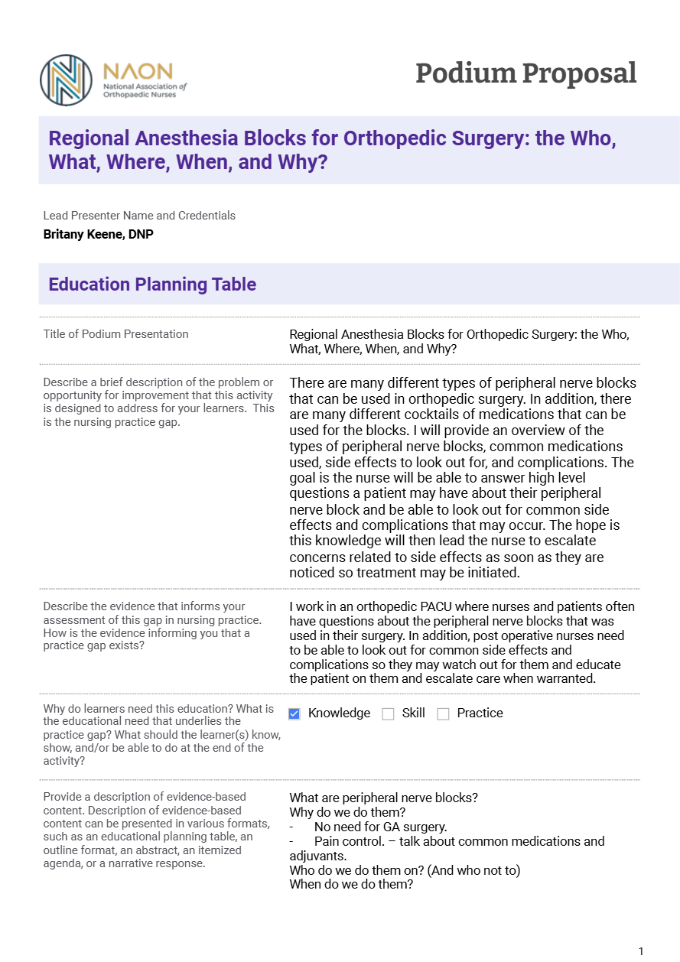

Slide 16
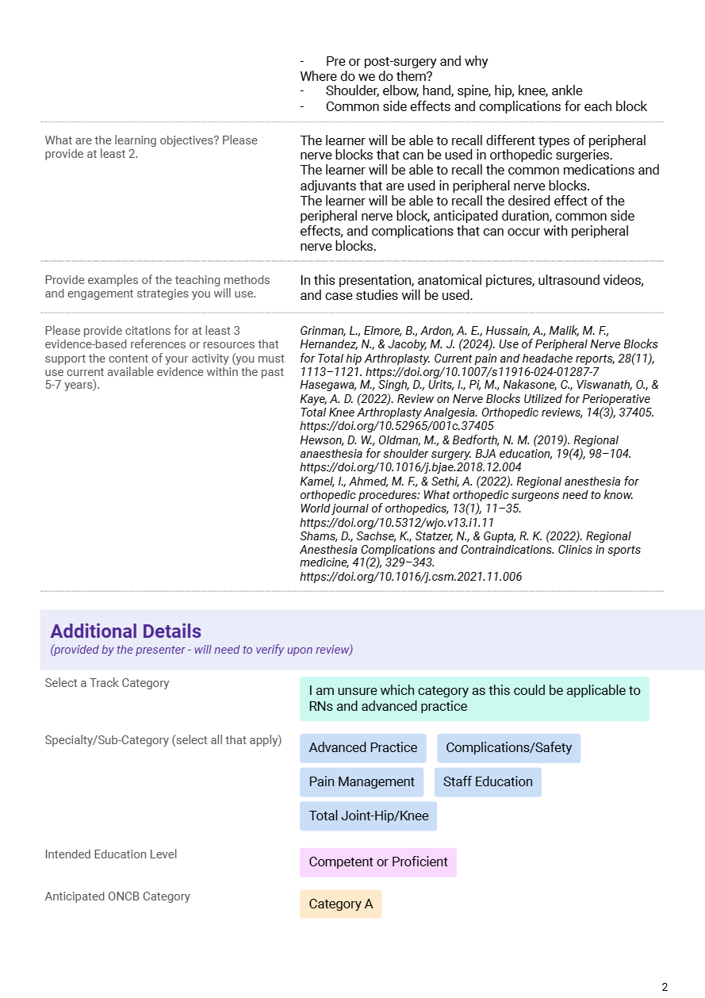

Slide 17
ANCC Perspective
In our live education (Congress, AAOS, Orthopaedic Nursing Review Course), on-line education, and webinars, what do our attendees get from NAON and what do they need this year in order to improve their practice? (Patient outcomes)

Slide 18
Who is Attending?
(Target audience)
What is the Primary Practice Setting? (Ortho or Medical-surgical unit, Operating room, Clinic or outpatient setting, MD office)
What job title or position? (Staff nurse, manager/admin/supervisor, NP/RNFA, educator)
Highest level of education (AD, BSN, MSN, DNP, PhD)
Years in orthopaedic nursing

Slide 19
Identifying the Practice Gap
Name 1-3 Topics you would like to learn more about or would improve your practice/outcomes (Learner Needs)
Pain Management Bundled payments Total Joint Population Trauma Quality and Outcomes Professional Development (management, teamwork, retention) | Specific anatomic topics (foot, ankle, spine, etc.) Infection Advance Practice topics OR/Surgery

Slide 20
Education practice change
Evaluating the Activity, attendee self-report
Did this session provide information that will cause you to make change(s) in your practice and/or employment environment? (Yes/No) (Quality Improvement measure/metric)
What is the result from this session with respect to your practice or employment environment? (QI metric)
  Not applicable to my current practice setting
  Gained knowledge/information for future
  Plan to share information with others
  Compared to current, may consider possible changes
  Plan to make changes in my practice
Comment on intended practice change (Quantitative data)

Slide 21
Intent to change practice based on education

Slide 22
Education practice change
Evaluating the conference, attendee self-report
Of all the sessions you evaluated/claimed, where you indicated that "Yes" you would make changes in your practice and/or employment environment based on what you learned, which session had the most influence on those changes?
Optional comment on intended practice change
Longitudinal Evaluation, assessing practice change on select sessions, random sample, 60-90 days later (incentivized)
Did you attend?
Since attending, what changes have you made (same scale as immediate evaluation)
Optional comments

Slide 23
Provider Unit Strategic Goals for NAON Education (pending Board approval)
Engage NAON members and other stakeholders of NAON Education in evidence based orthopaedic education meant to improve patient outcomes and enhance professional development.
Utilize feedback from NAON Education activity evaluations when developing and revising future educational activities and products.
Increase perception of value of Annual Congress event to NAON members
  Select high quality podium presentations, prioritizing innovative topics as well as Category A Contact hours and Pharmacology credit.
  Incorporate ANCC criteria/guidelines into Congress evaluation to enhance information and feedback regarding application of education to the practice environment.
Increase value to NAON members through the provision of high-quality continuing nursing education that supports the lifelong learning needs of its Orthopaedic professional registered nurses.
  Identify gaps in practice or gaps in education that members experience
  Consider diverse practice environments, educational preparation, level of expertise of members and learning preferences in developing activities and products for continuing education
  Provide or plan 6 new webinars per year (live or pre-recorded)

Slide 24

Mission:
To advance the specialty of orthopaedic nursing in education, research, application of best practices, and to provide professional development and collaboration opportunities.
Value Statement:
NAON promotes a culture of professional collaboration developed through trust, respect, integrity and passion for the specialty of orthopaedics. NAON values integrity, trust, vision, innovation, and stewardship.
Vision Statement:
NAON is the premier professional society for all orthopaedic nurses and allied health professionals caring for patients in all practice settings with musculoskeletal conditions. NAON offers easy access to valuable knowledge, information, and resources, while creating a supportive and inclusive community.
NAON strives to become the trusted source for patients and caregivers for information on musculoskeletal conditions and care options, helping them to feel empowered about their health and well-being.

Slide 25
NAON Education Product Line (Opportunities)
Live Conferences
Live Courses
Webinars (live/recorded)
Patient Education Manuals
NAON Practice Points
Clinical Practice Guidelines
Best Practice Guidelines
Intro to Ortho Manual
Core Curriculum
Networking (Issues in Practice Discussion Forum, monthly Nurse Navigator meeting)
NAON News Blog
Orthopaedic Nursing Journal
Position Statements
Scope and Standards
Certification exam preparation
  Practice questions ONC, ONP-C
  ONRC On-line Course

Slide 26
RESPONSIBILITIES of NEC Members
By December 31, 2025 each NEC member is requested to:
• Complete orientation to ANCC Guidelines for CNE (1 hour presentation or recording)
Gain familiarity with NAON website (report any flaws found, such as navigating the website, finding a product, etc)
• Review at least two NAON Education products and resources currently available.
• Identify practice gaps and opportunities for NAON Education for the coming year
• Provide feedback and suggestions for the Committee to review

Slide 27
RESPONSIBILITIES of NEC Members
During the one year between Congress 2025 and Congress 2026, each member will:
(Required) participate in scoring, judging, reviewing Congress preparation activities including peer-review of slide decks. This includes scoring posters being considered for acceptance (Fall) as well as poster judging (Spring)
• assist in decisions made regarding needed revisions during the year by providing feedback and suggestions
• contribute to revising at least one product/activity per year.
• facilitate development of, and author (or co-authors) a new educational product or activity.
• serve as final reviewer for assigned educational products developed for NAON Education. This includes peer-review of slide decks for webinars or live conferences, documents and on-line products (approximately 3 per year)
• Contribute to at least one NAON Strategic Plan objective
• Serve as a moderator for a webinar, Congress Session or member forum
• Participate in an annual onsite meeting (if held,), virtual meetings, and conference calls as requested.

Slide 28
Committee member responsibilities
Live Conferences
Live Courses
Webinars (live/recorded)
Patient Education Manuals
NAON Practice Points
Clinical Practice Guidelines
Best Practice Guidelines
Intro to Ortho Manual
Core Curriculum
Networking (Issues in Practice Discussion Forum, monthly Nurse Navigator meeting)
NAON News Blog
Orthopaedic Nursing Journal
Position Statements
Scope and Standards
Certification exam preparation
  Practice questions ONC, ONP-C
  ONRC On-line Course

Slide 29


Slide 30
Questions???

Slide 31
Reviewing a Power Point Slide deck for a presentation
2. Assess content (MBS webinars have an evaluation form)
  Is the content
  a) free of factual errors?..................…….. Yes No N/A
  b) appropriate in length?............................................ Yes No N/A
  c) well organized?...................................................... Yes No N/A
  d) reflective of current evidence and/or research?... Yes No N/A
  e) a strong test of knowledge?......................... Yes No N/A
  f) enhanced by the graphics?...................................... Yes No N/A
  g) in need of additional graphics?.............................. Yes No N/A
  h) reference appropriate for each question?............... Yes No N/A
  i) overall reference list current? Yes No N/A

Slide 32

Reviewing a Power Point Slide deck for a presentation
5. Assess format
  Grammar, Spelling, Punctuation. (professionalism)
  Consistency with Font Size and Style (Header may vary in both size and style from the text on the slide)
  The general standard is a range from 18 to 36 Font size (varies based on the circumstances). Consider the devices that will be used for the education (phone, laptops, big screen)
  White space on the screen (40-50%)
  Use of key words and bullet points instead of full sentences that look like they will be read to the audience
  5X5 rule (Microsoft best practices) No more than 5 bullet points on the screen, no more that 5 words per bullet point

Slide 33


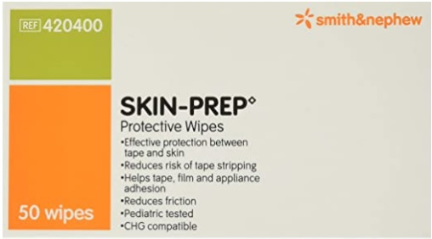
Reviewing a Power Point Slide deck for a presentation
4.Assess Graphics
Graphics must be relevant to the education and should be used to enhance the education through engagement/interactivity/ amplifying the educational content
If there is a question regarding a graphic, the reviewer can ask the presenter, or direct the question/concern to Tandy.
Includes photographs, images from the internet or other sources, Smart Art, data graphs… basically anything that is not text.
The presenter/author is responsible to provide graphics that are either owned by the presenter or the presenter/author has permission to share them in the education. Some images are available for use without license or fee (Google is one of many publicly available image websites)
Graphics cannot be promotional

